Slide 1
Person ReID
Zhao Qun
2019.11.30

Slide 2
Outline
Introduction
Dataset and Evaluation
Existing Methods
Papers

Slide 3
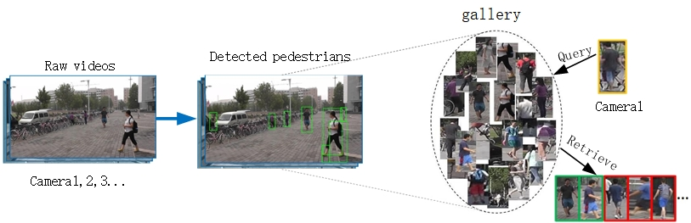
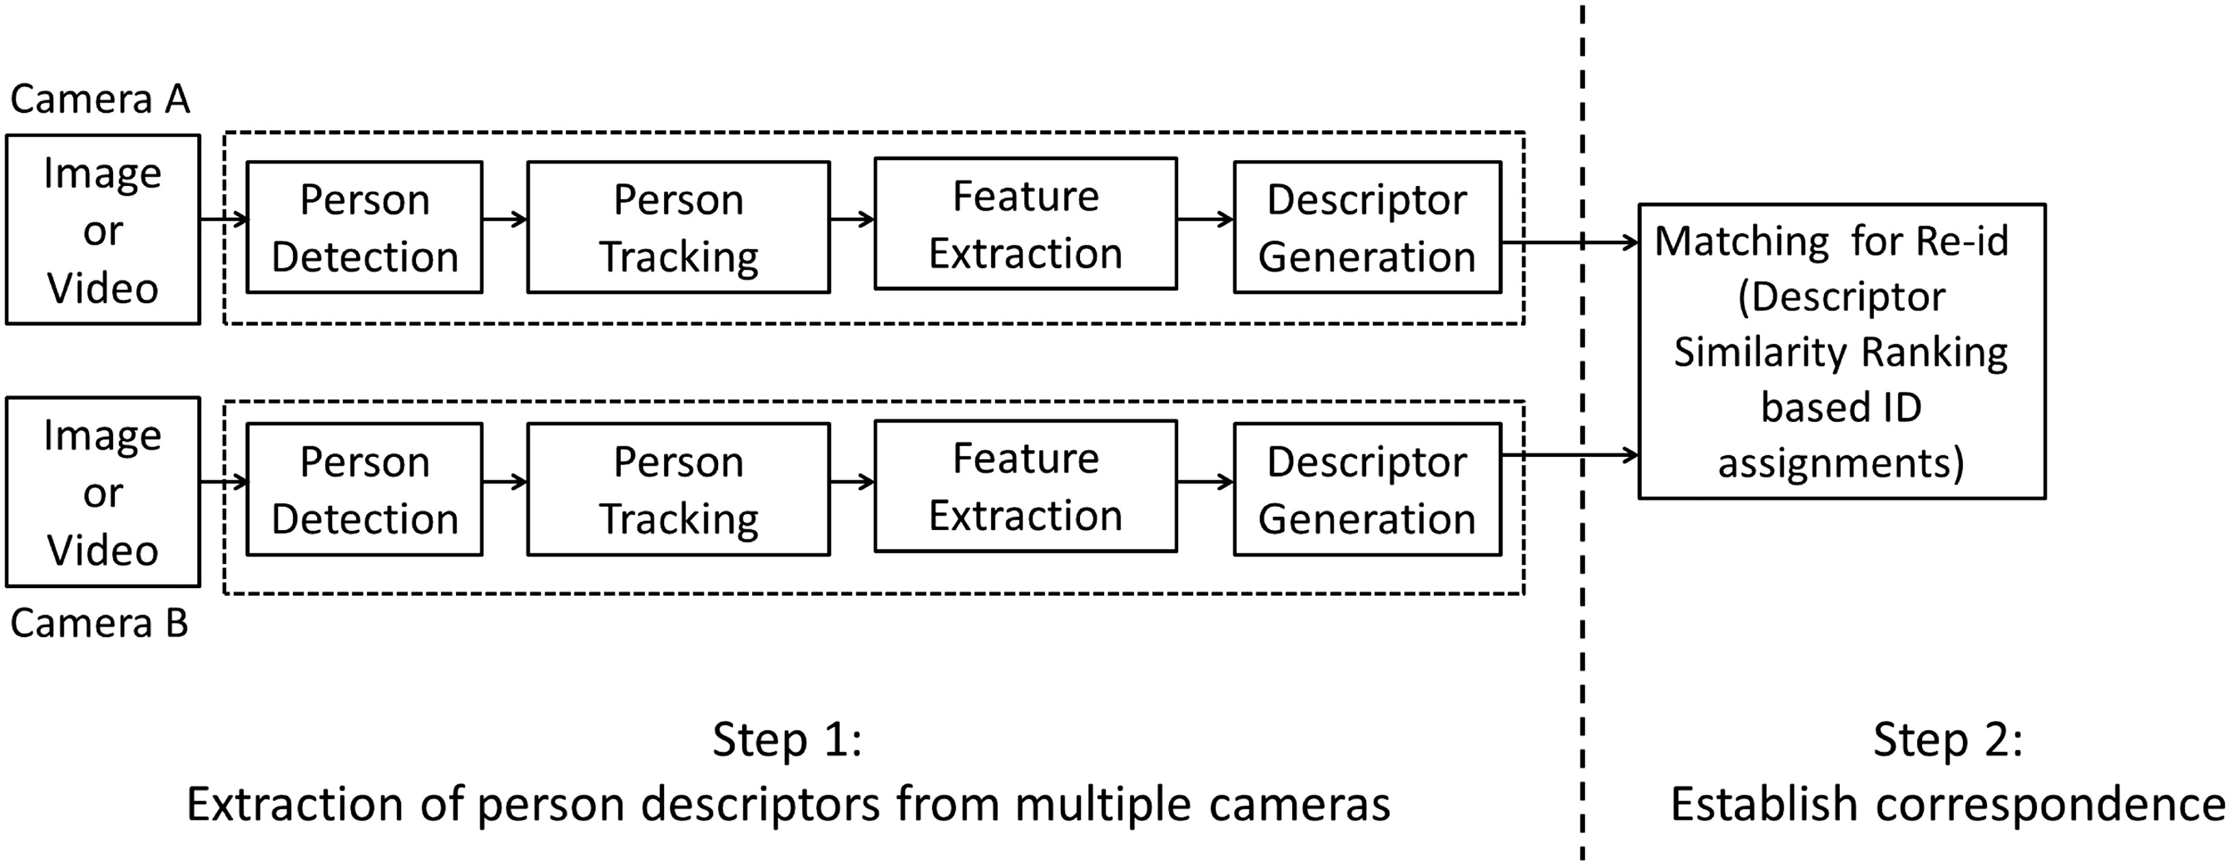
Introduction
Using computer vision algorithms to track across cameras to find the same person under different cameras is also a sub-problem of image retrieval.

Slide 4
Dataset
Dataset | Release | Identities | Images | Cameras | Images per Identity
VIPeR | 2007 | 632 | 1264 | 2 | 2
GRID | 2009 | 1025 | 1275 | 8 | 1.24
PRID2011 | 2011 | 934 | 24541 | 2 | 26.28
CUHK03 | 2014 | 1467 | 13164 | 2 | 8.97
Market-1501 | 2015 | 1501 | 32217 | 6 | 21.46
DukeMTMC-reID | 2017 | 1812 | 36441 | 8 | 20.11
Airport | 2017 | 9651 | 39902 | 6 | 4.13
MSMT17 | 2018 | 4101 | 126441 | 15 | 30.83

Slide 5










Evaluation
Rank-n：Rank-n Accuracy
mAP：Mean Average Precision）
P1: Rank-1=1/1=100%
Rank-5=3/5=60%
Rank-10=5/10=50%
P1
1
3
5
8
10
AP:
P1:(1/1+2/3+3/5+4/8+5/10)/5=0.6533
P2:(1/1+2/3+3/5)/3=0.7556
mAP:
(P1+P2)/2=0.7055
P2
1
3
5

Slide 6
Existing Methods
Resnet
Backbone
Densnet
2018ECCV--Beyond Part Models Person Retrieval with Refined Part Pooling
PCB+RRP
Global
Supervised
Feature
Strong Baseline
Local
2019CVPR--Bag of Tricks and A Strong Baseline for Deep Person Re-identification
Channel
Attention Learning
Attention
2019--Domain Adaptive Attention Model for Unsupervised Cross-Domain Person Re-Identification
Person ReID
Spatial
Unsupervised
2019ICCV--Self-similarity Grouping A Simple Unsupervised Cross Domain Adaptation Approach for Person Re-identification
SSG
re-Ranking
Base Application
Triple/Center loss
2019CVPR--Joint Discriminative and Generative Learning for Person Re-identification
GAN
Trick
Random Erasing
...

Slide 7
Existing Methods
Resnet
Backbone
Densnet
2018ECCV--Beyond Part Models Person Retrieval with Refined Part Pooling
PCB+RRP
Global
Supervised
Feature
Strong Baseline
Local
2019CVPR--Bag of Tricks and A Strong Baseline for Deep Person Re-identification
Channel
Attention Learning
Attention
2019--Domain Adaptive Attention Model for Unsupervised Cross-Domain Person Re-Identification
Person ReID
Spatial
Unsupervised
2019ICCV--Self-similarity Grouping A Simple Unsupervised Cross Domain Adaptation Approach for Person Re-identification
SSG
re-Ranking
Base Application
Triple/Center loss
2019CVPR--Joint Discriminative and Generative Learning for Person Re-identification
GAN
Trick
Random Erasing
...

Slide 8
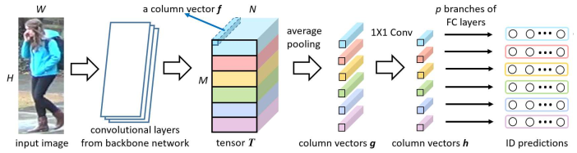
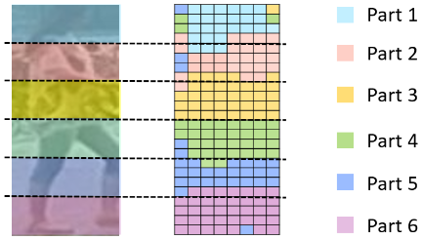
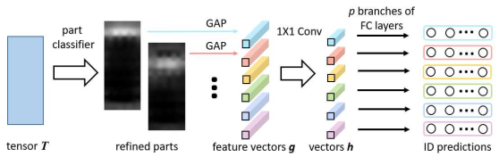
Papers
2018ECCV--Beyond Part Models Person Retrieval with Refined Part Pooling
PCB: a uniform partition
RPP: refined part pooling to correct within-part inconsistency

Slide 9
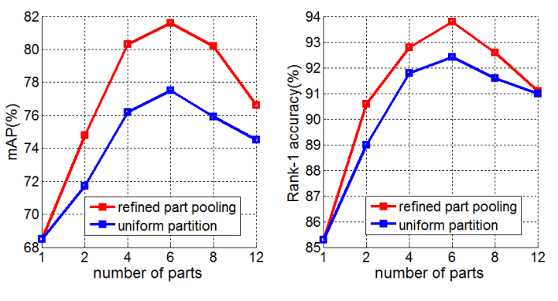
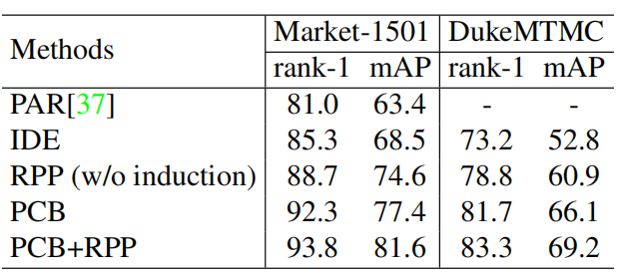
Papers
2018ECCV--Beyond Part Models Person Retrieval with Refined Part Pooling
Impact of p. Rank-1 accuracy and mAP are compared.Compare PCB both with and without the refined part pooling.

Slide 10
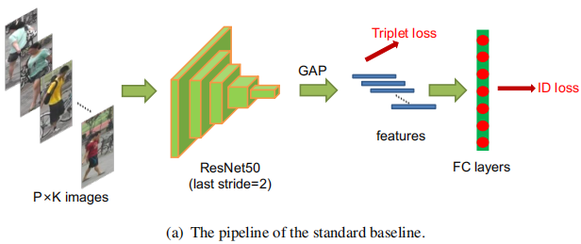
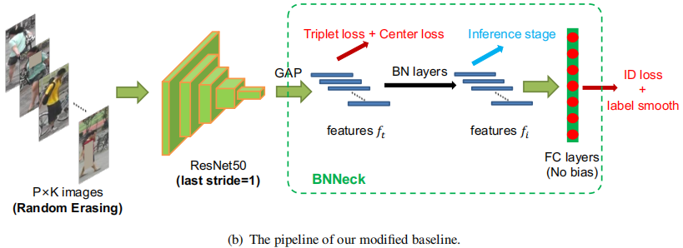
Papers
2019CVPR--Bag of Tricks and A Strong Baseline for Deep Person Re-identification
1) acquire the normalized feature f_{i}
2) reduces the constraint of the ID loss on f_{t}

Slide 11
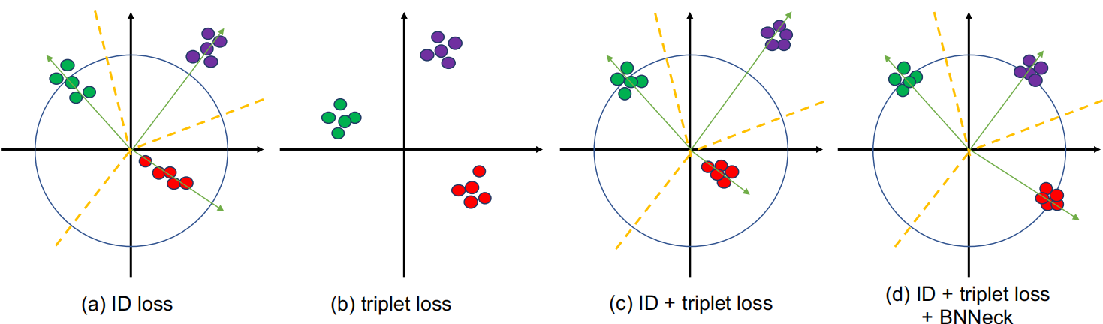
Papers
2019CVPR--Bag of Tricks and A Strong Baseline for Deep Person Re-identification
ID loss mainly optimizes the cosine distances while triplet loss focuses on the Euclidean distances.Using these two losses to optimize the eigenvectors simultaneously, their objectives may be inconsistent resulting in the reduction of one loss and the oscillation or increase of the other.To overcome the aforementioned problem, we design a structure named as BNNeck.

Slide 12
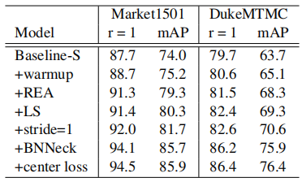
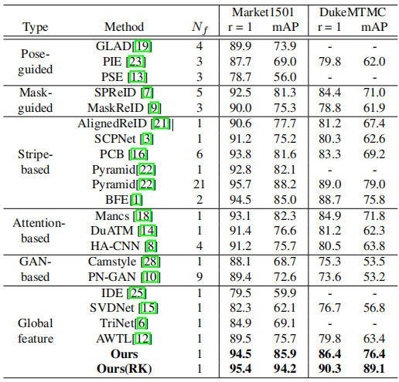
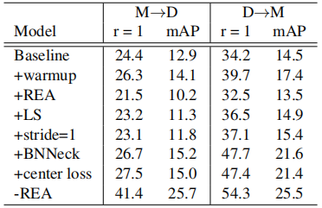
Papers
2019CVPR--Bag of Tricks and A Strong Baseline for Deep Person Re-identification
Same domain result
Cross domain result

Slide 13
Existing Methods
Resnet
Backbone
Densnet
2018ECCV--Beyond Part Models Person Retrieval with Refined Part Pooling
PCB+RRP
Global
Supervised
Feature
Strong Baseline
Local
2019CVPR--Bag of Tricks and A Strong Baseline for Deep Person Re-identification
Channel
Attention Learning
Attention
2019--Domain Adaptive Attention Model for Unsupervised Cross-Domain Person Re-Identification
Person ReID
Spatial
Unsupervised
2019ICCV--Self-similarity Grouping A Simple Unsupervised Cross Domain Adaptation Approach for Person Re-identification
SSG
re-Ranking
Base Application
Triple/Center loss
2019CVPR--Joint Discriminative and Generative Learning for Person Re-identification
GAN
Trick
Random Erasing
...

Slide 14
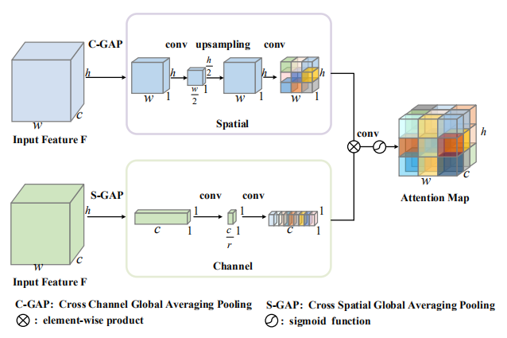
Papers
2019--Domain Adaptive Attention Model for Unsupervised Cross-Domain Person Re-Identification
Spatial attention aims to learn domain-shared regions and channel attention aims to pay more attention to the domain-shared kernels.

Slide 15
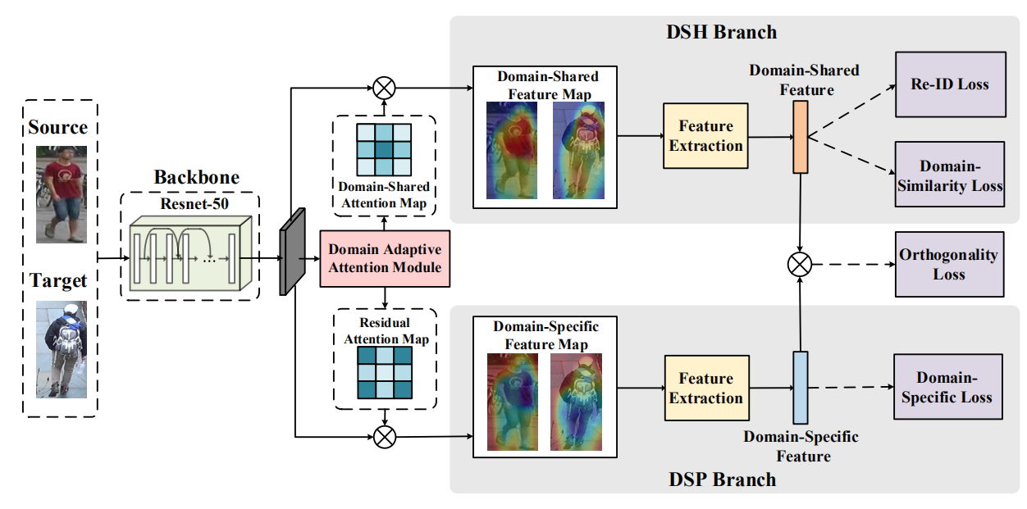
Papers
2019--Domain Adaptive Attention Model for Unsupervised Cross-Domain Person Re-Identification
The domain adaptive attention module separates the feature map into domain-shared (DSH) and domain-specific feature maps simultaneously. Then, a DSH branch and a DSP branch are introduced to learn these two feature maps respectively. The Re-ID loss and domain similarity loss are adopted to the DSH branch to make the DSH feature discriminative to different persons and transferable to different domains. In contrary, the domain-specific loss is employed to make the DSP branch to capture the domain distinguishable information to avoid to distract the DSH feature. Finally, the soft orthogonality constraint is introduced to make these two parts complementary and separable.
The framework of the proposed method

Slide 16
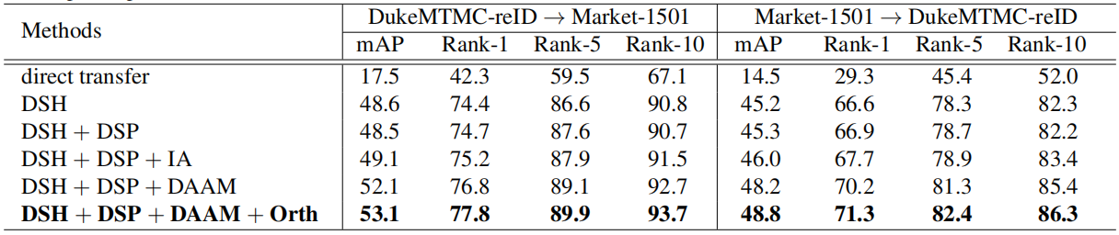
Papers
2019--Domain Adaptive Attention Model for Unsupervised Cross-Domain Person Re-Identification

Slide 17
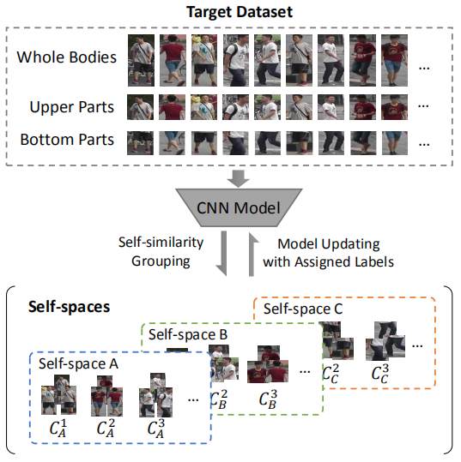
Papers
2019ICCV--Self-similarity Grouping A Simple Unsupervised Cross Domain Adaptation Approach for Person Re-identification
Illustration of proposed Self-similarity Grouping (SSG).
We group target images by three cues, whole bodies, upper parts and bottom parts, independently and assign labels according to the corresponding group. The global information of the whole body and the local information of body parts can help us learn a better representation of individuals.

Slide 18
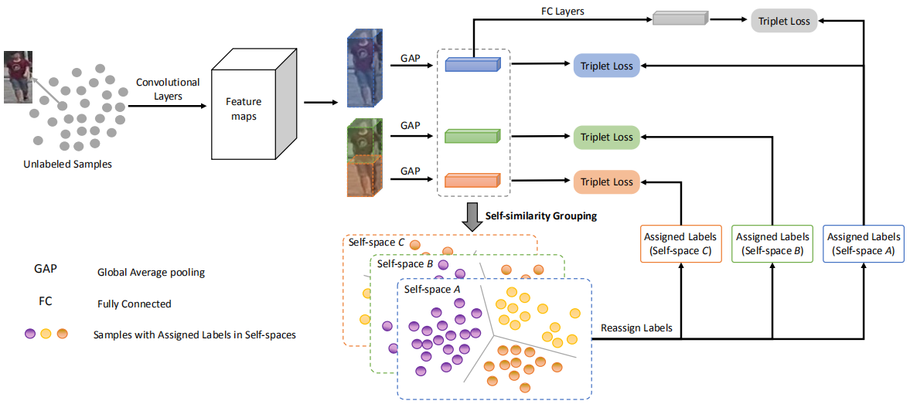
Papers
2019ICCV--Self-similarity Grouping A Simple Unsupervised Cross Domain Adaptation Approach for Person Re-identification
(1) Split the feature maps into an upper part and a lower part and employ GAP on the whole, upper and lowerfeature maps.
(2) Then, group person images with different feature representations(blue, green and orange) and assign each different self-pseudo labels by grouping results(A, B, C).
(3) Next, update the CNN model by minimizing the triplet loss with each pseudo label.
(4) During testing, concatenate three feature representations together as the final representation of query person.

Slide 19
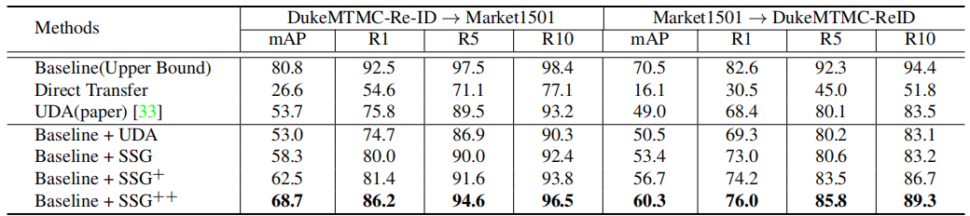
Papers
2019ICCV--Self-similarity Grouping A Simple Unsupervised Cross Domain Adaptation Approach for Person Re-identification

Slide 20
Existing Methods
Resnet
Backbone
Densnet
2018ECCV--Beyond Part Models Person Retrieval with Refined Part Pooling
PCB+RRP
Global
Supervised
Feature
Strong Baseline
Local
2019CVPR--Bag of Tricks and A Strong Baseline for Deep Person Re-identification
Channel
Attention Learning
Attention
2019--Domain Adaptive Attention Model for Unsupervised Cross-Domain Person Re-Identification
Person ReID
Spatial
Unsupervised
2019ICCV--Self-similarity Grouping A Simple Unsupervised Cross Domain Adaptation Approach for Person Re-identification
SSG
re-Ranking
Base Application
Triple/Center loss
2019CVPR--Joint Discriminative and Generative Learning for Person Re-identification
GAN
Trick
Random Erasing
...

Slide 21
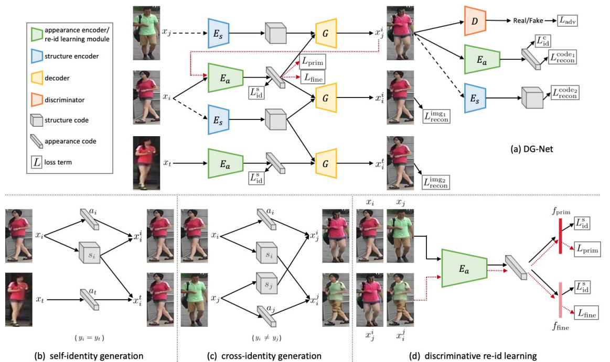
Papers
2019CVPR--Joint Discriminative and Generative Learning for Person Re-identification
A schematic overview of DG-Net.
(a) Our discriminative re-id learning module is embedded in the generative module by sharing appearance encoder Ea. A dash black line denotes the input image to structure encoder Es is converted to gray. The red line indicates the generated images are online fed back to Ea.
Two objectives are enforced in the generative module: (b) self-identity generation by the same input identity and (c) cross-identity generation by different input identities.
(d) To better leverage generated data, the re-id learning involves primary feature learning and fine-grained feature mining.

Slide 22
Q & A TANKS
Person ReID

